Slide 1

CS232
Final Project
NYC
Taxi Trips
Notes:
Hello everyone. I’m Minjae Kyung, and I'll start the CS232 Final project presentation.

Slide 2


2013
Introduction
Tools
Notes:
The goal of this presentation is to analyze 45GB of the operational data of New York taxis in 2013 and create and analyze various interesting data.

Slide 3






Introduction
Tools
Matplotlib
Gmaps
Pandas
Payment
Type
Notes:
The tools used for this analysis include Visual Studio Code, Jupyter Notebook, Python, and pytjon modules like Matplotlib, Pandas, and Gmaps.

Slide 4
Tools
Gmaps
Notes:
(4~5) To use the Gmaps module here, I had to overcome several obstacles. First of all, Gmaps does not support Visual Studio Code. There was no information about this anywhere, so I struggled for about 4 hours to get it working in VS Code, and this is the conclusion I came to.

Slide 5
Tools
Troubleshooting
Gmaps
Notes:
(4~5) To use the Gmaps module here, I had to overcome several obstacles. First of all, Gmaps does not support Visual Studio Code. There was no information about this anywhere, so I struggled for about 4 hours to get it working in VS Code, and this is the conclusion I came to.

Slide 6
Troubleshooting
< 7.0
Gmaps
Notes:
So, ultimately, if you want to use Gmap, you have to use Jupyter Notebook. However, the nbextension module required for Gmaps is no longer supported since Jupyter 6.0 and is completely deprecated in versions 7.0 and above, making it no longer compatible.

Slide 7

Troubleshooting
Gmaps
Notes:
And even if you overcome all these obstacles, you will encounter the error like this image. This means that your Python module and Jupyter are completely entangled.

Slide 8

Troubleshooting
Gmaps
Notes:
And in order to resolve this situation, you will experience countless errors in Python modules, Jupyter, etc., while trying various solutions.

Slide 9


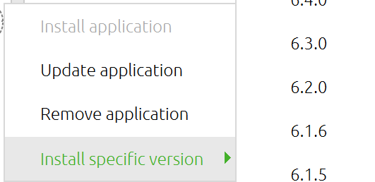
Troubleshooting
Gmaps
6.7.5
Notes:
But I finally found a solution, which is to reinstall Anaconda and Jupyter. After reinstalling Anaconda, if you click the gear button in Jupyter Notebook, there will be a menu called "Install specific version". Install version 6.7.5 there.

Slide 10


Troubleshooting
Gmaps
Notes:
(10-11) There's one thing to be careful about here. Even if you delete Anaconda, the cache files for this program are not deleted, and if you don't delete them, newer and more interesting bugs will be waiting for you. To prevent this, you need to find the folders where the program's cache files are stored and delete them completely.

Slide 11



Troubleshooting
Gmaps
Notes:
(10-11) There's one thing to be careful about here. Even if you delete Anaconda, the cache files for this program are not deleted, and if you don't delete them, newer and more interesting bugs will be waiting for you. To prevent this, you need to find the folders where the program's cache files are stored and delete them completely.

Slide 12
Troubleshooting
pip uninstall <everything related with Jupyter>
pip cache purge
Gmaps
Notes:
And since the Python modules might be tangled up, you should delete them completely.

Slide 13

pip uninstall <everything related with Jupyter>
pip cache purge
Troubleshooting
Gmaps
Notes:
If you deleted all cache files and you succeed in completely reinstalling Anaconda and Jupyter Notebook, you will finally be able to use the gmaps module.

Slide 14



Troubleshooting
Gmaps
Notes:
(15-16) But there's another thing to be careful about here. If you turn off your computer and turn it back on, a big, beautiful error will be waiting for you again. And I've completely reset and reinstalled twice in this state, but unfortunately, I haven't found a solution.

Slide 15
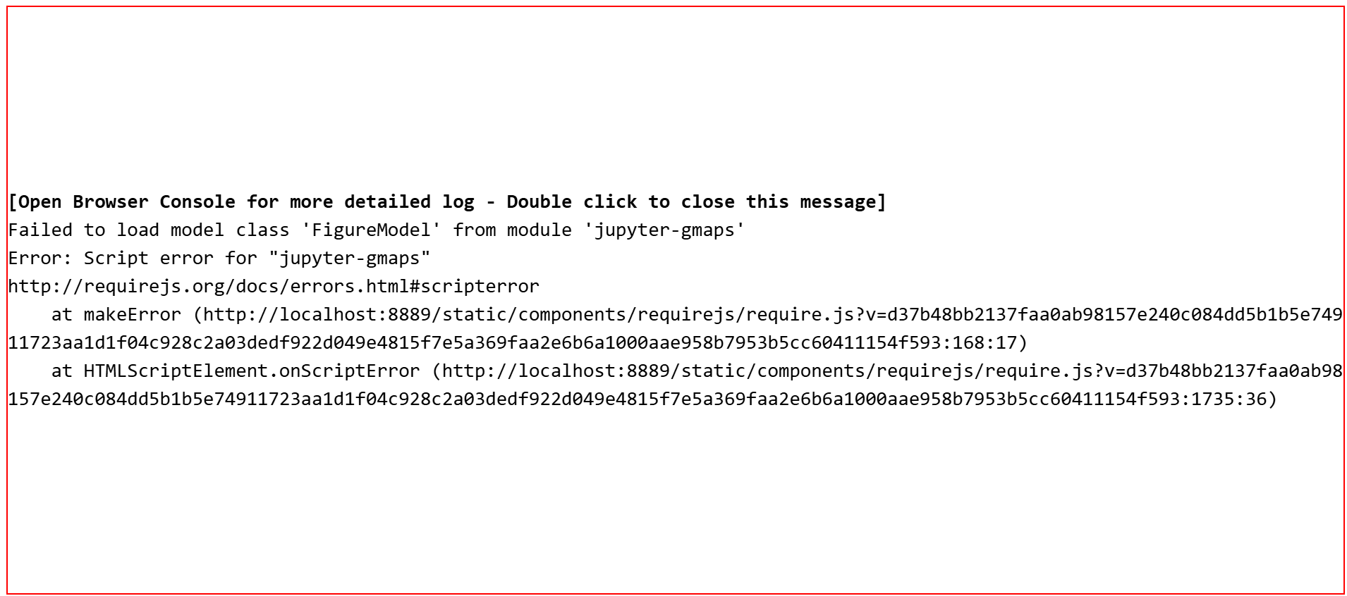
Troubleshooting
Gmaps
Notes:
(15-16) But there's another thing to be careful about here. If you turn off your computer and turn it back on, a big, beautiful error will be waiting for you again. And I've completely reset and reinstalled twice in this state, but unfortunately, I haven't found a solution.

Slide 16
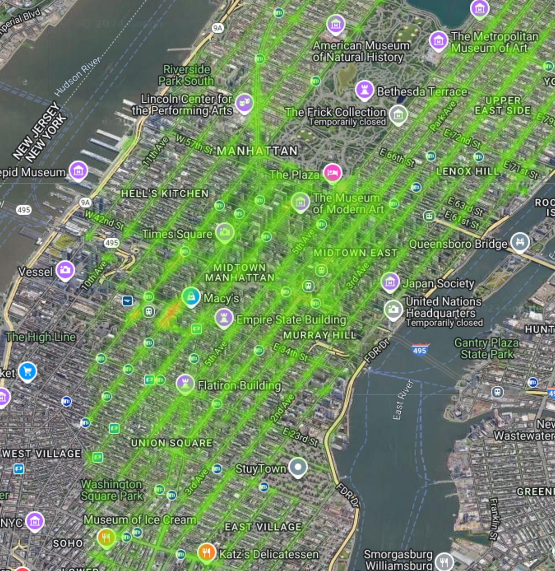
Troubleshooting
Gmaps
Dropoff
Location
Notes:
Fortunately, I had one image saved before rebooting. Now, let's analyze the map based on this. The heatmap on this map shows where taxis drop off customers, and it shows that they stop uniformly on most roads in Manhattan. However, one noticeable area is that the 7th Ave and 8th Ave surrounding Madison Square is a bit red. The reason why the heatmap doesn't appear on the left is because I accidentally deleted coordinates inside Manhattan while adjusting anomalous coordinates in the data. And the picture I captured at that time was the only one that was preserved, so I had no choice but to use this picture. Fortunately, there were no noticeable heatmaps in the unsaved areas. Also, outside of Manhattan, there were noticeable heatmaps at the two airports east of Manhattan. This is also not preserved.

Slide 17
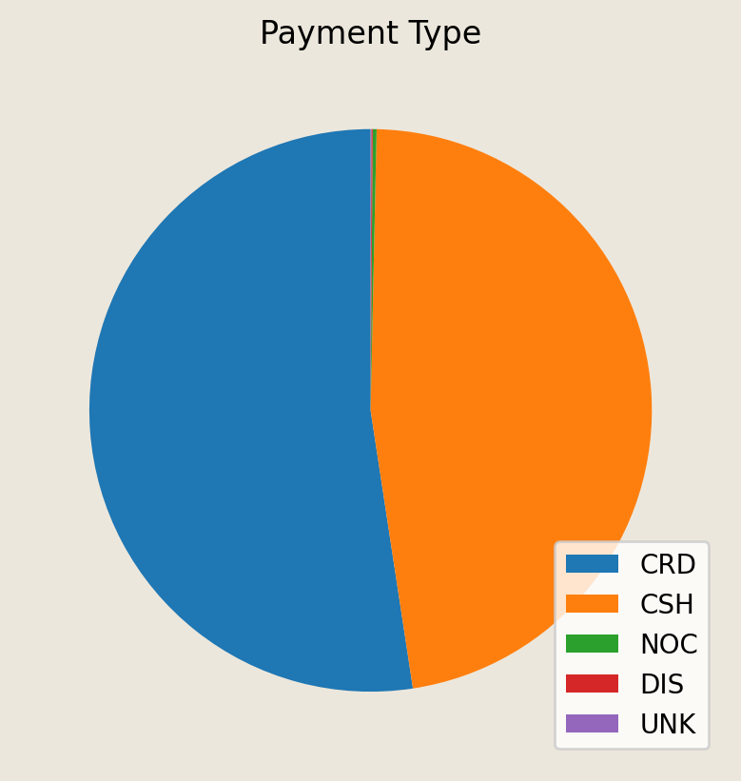
Dropoff
Location
Payment
Type
Notes:
Now, let's look at various data using the familiar matplotlib. First, I briefly checked how taxi customers paid, and cards accounted for a slightly more than half of the payments compared to cash. And in a very small percentage of cases, we can see that the no cash and there was a dispute, but it's almost negligible.

Slide 18
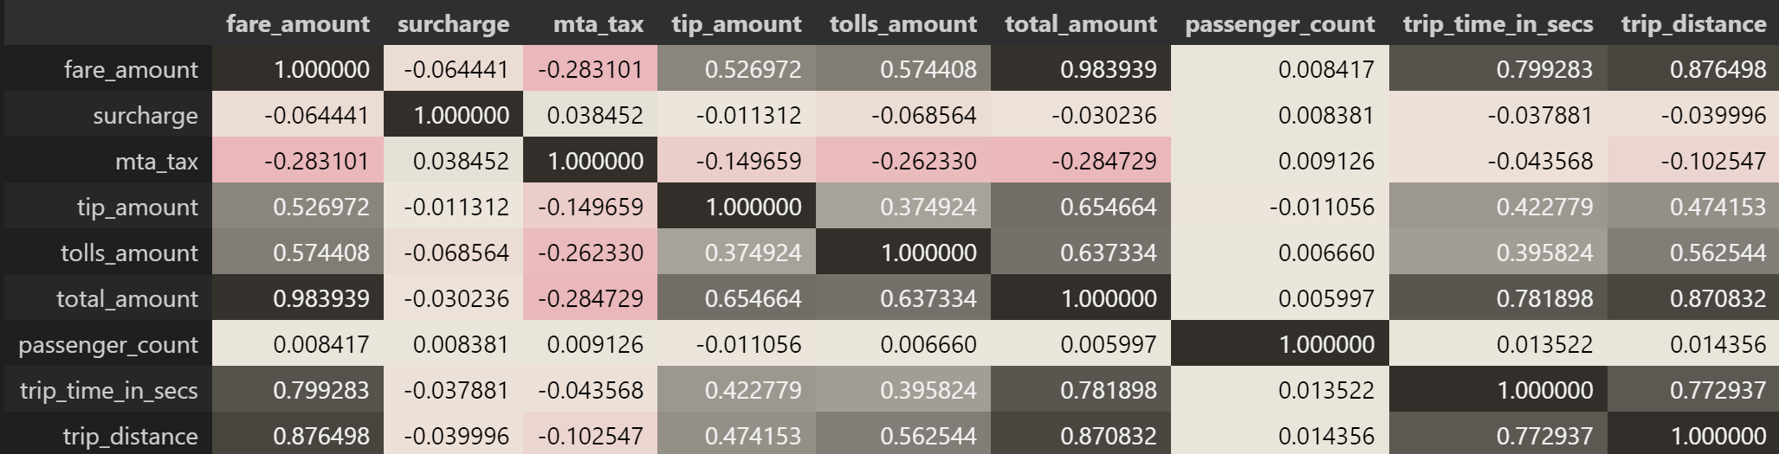
Fare Correlation Chart
Payment
Type
Trip
Distance
Notes:
Looking at this correlation chart, we can see some interesting facts. First, due to the nature of taxis as a means of transportation, the number of passengers does not significantly affect the fare. And the fare amount has a strong correlation with trip distance and trip time, with distance having a slightly stronger correlation. Also, the mta_tax has a weak negative correlation with fares, so I looked into it and found that the mta_tax was mostly charged at a fixed rate. Considering this, I would guess that taxi drivers might prefer longer distances a little more.

Slide 19
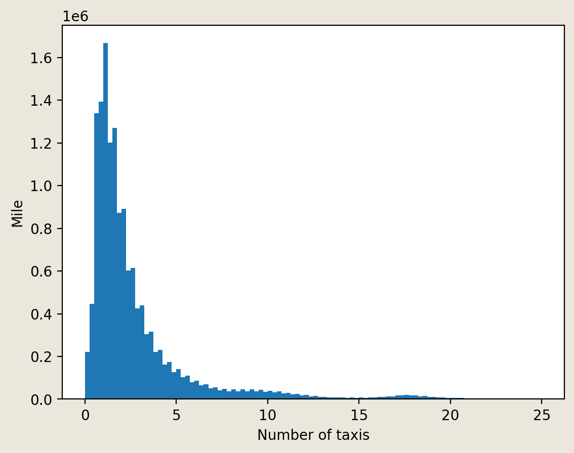
Correlation Chart
Trip
Distance
Traffic
Per
Time
Notes:
I also graphed how far taxi drivers travel on average. Looking at this, it seems to be a normal distribution graph skewed to the left, centered around 2 miles.

Slide 20
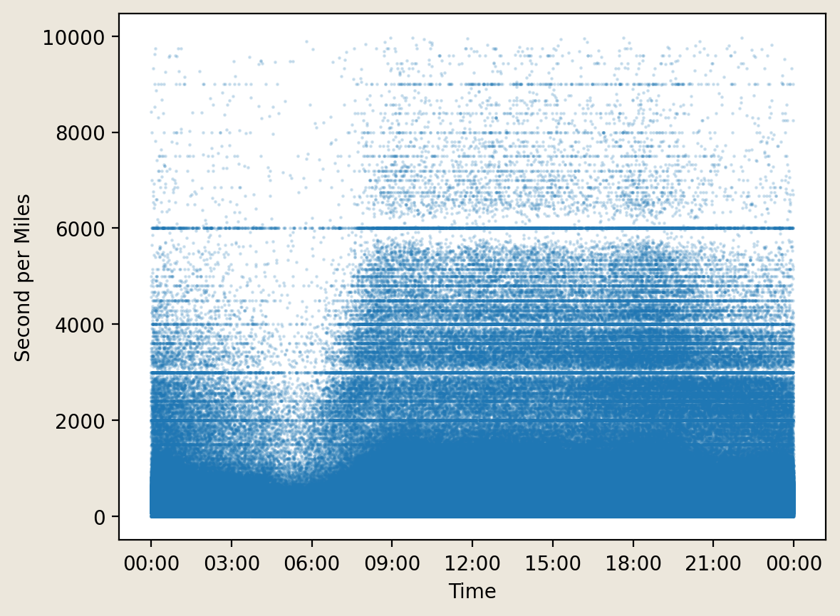
Trip
Distance
Traffic
Per
Time
Earning
per
Day
Notes:
To find out the traffic volume in New York, I organized the time taken per mile into a scatter plot. It shows a generally uniform speed from 9 AM to 9 PM, and after that, the second per mile decreases, perhaps as traffic starts to ease, with the least traffic around 5 AM.

Slide 21
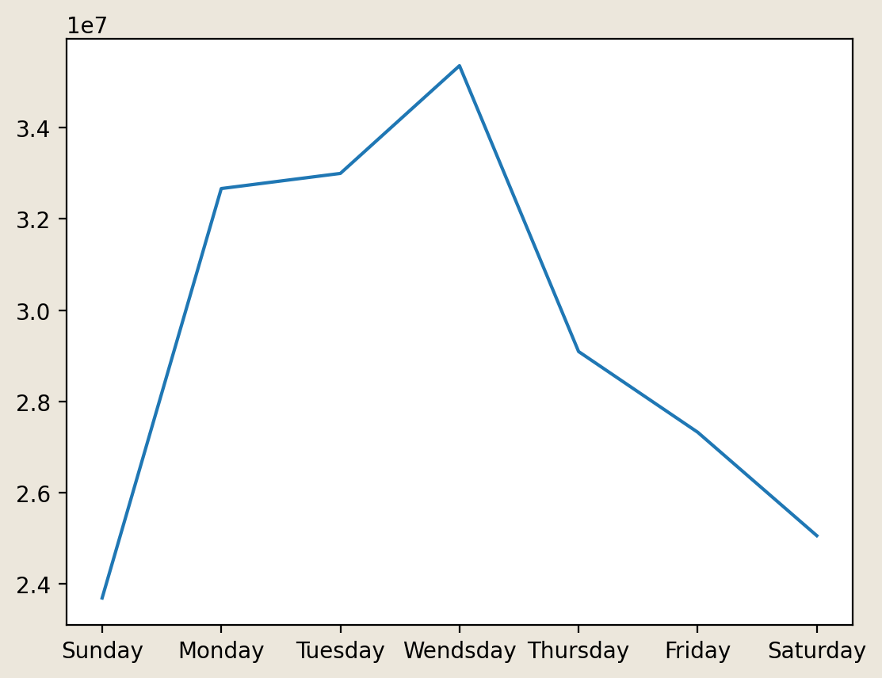
Traffic
Per
Time
Earning
per
Day
Earning
per
Month
Notes:
To see which day of the week is the most profitable, I summed up the earnings for each day and plotted them on a graph. It shows that the total earnings on weekends are lower than on other days, and Wednesday has the highest earnings.

Slide 22
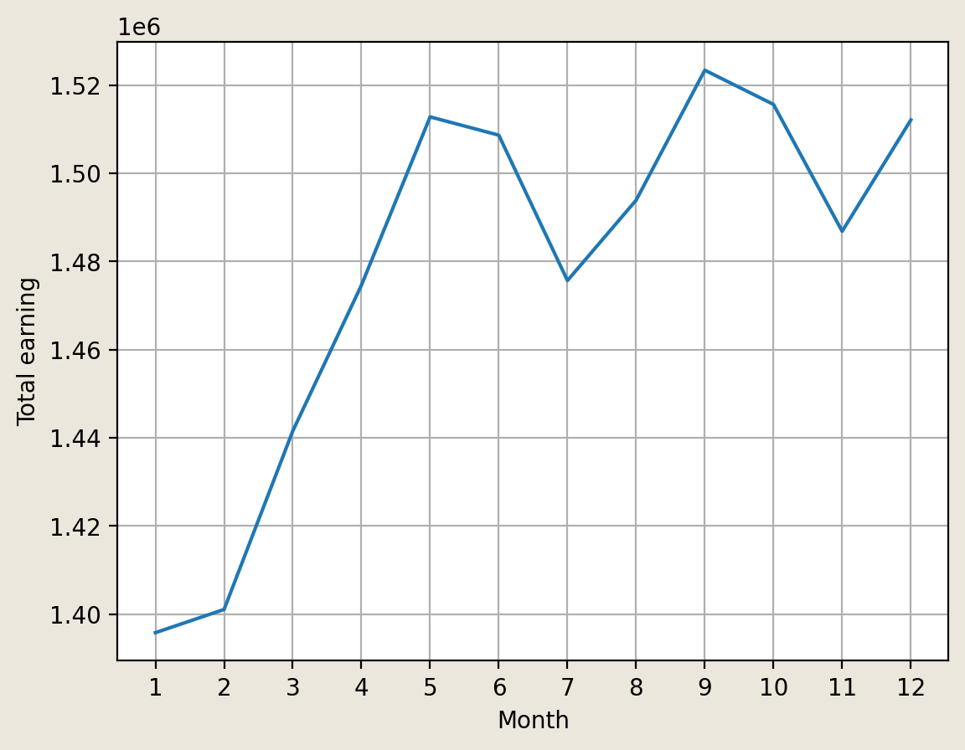
Earning
per
Day
Earning
per
Month
Average
Pay
Notes:
I also looked at the monthly earnings, and it shows that the total earnings were relatively low in January and February, then surged from March, and plateaued from June, but overall, it shows an upward trend.

Slide 23
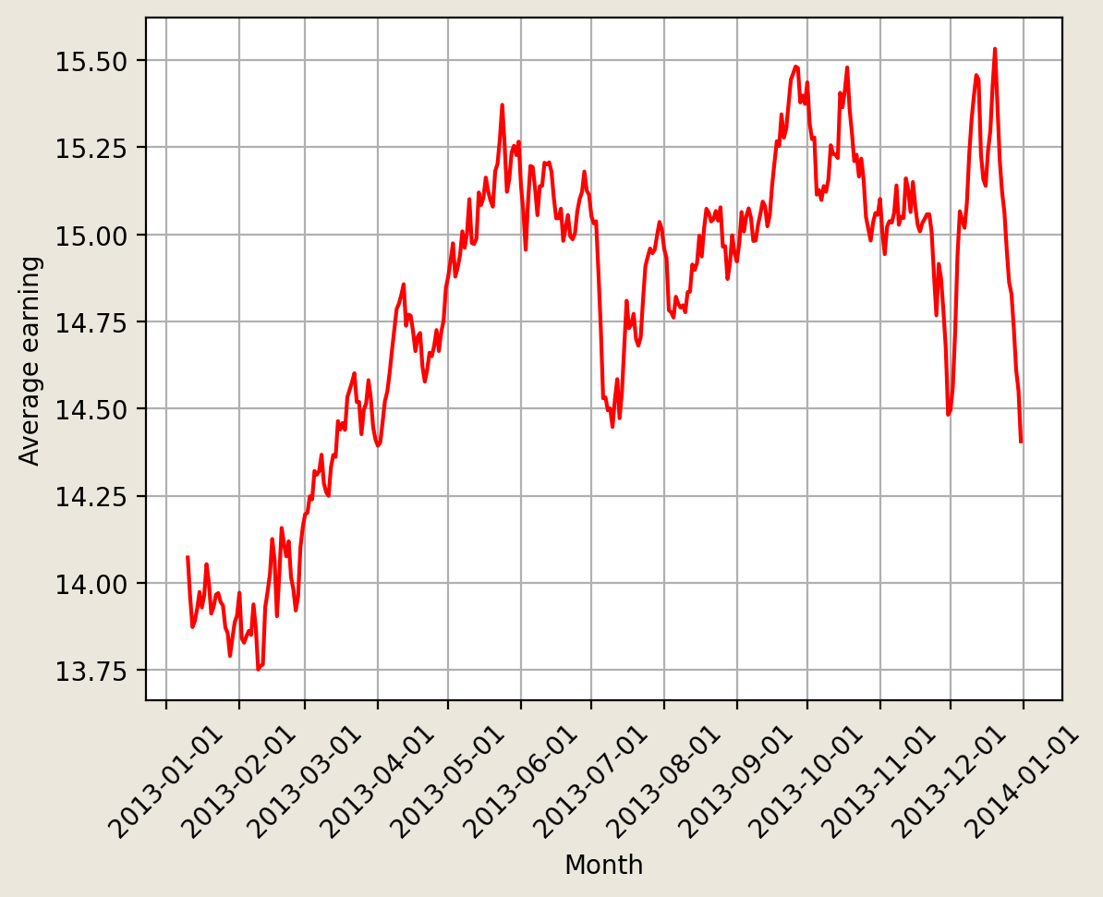
Earning
per
Month
Average
Pay
Number
Of
Rides
Notes:
I was curious after seeing the Earning per month graph, so I looked at the average income, and the results were quite interesting. Looking at this graph, it seems to show results quite similar to the previous total revenue graph.

Slide 24
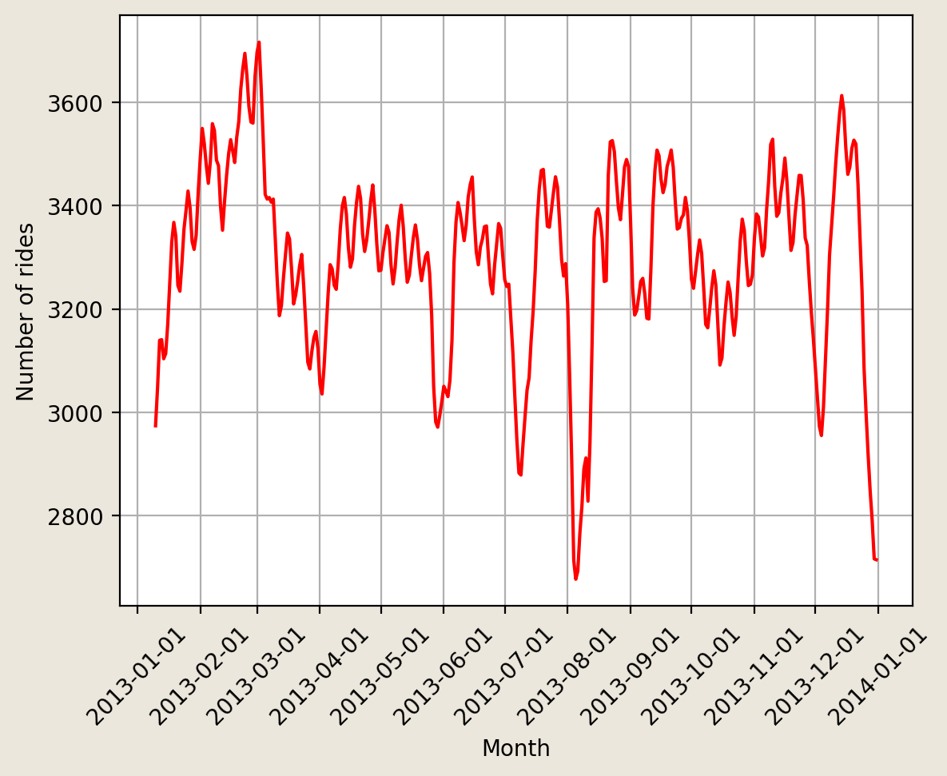
Average
Earning
Over
Month
Number
Of
Rides
Total
Earnings
Per
Day
Notes:
So, this time, I calculated the number of daily rides, and it shows a graph that is generally stagnant.

Slide 25
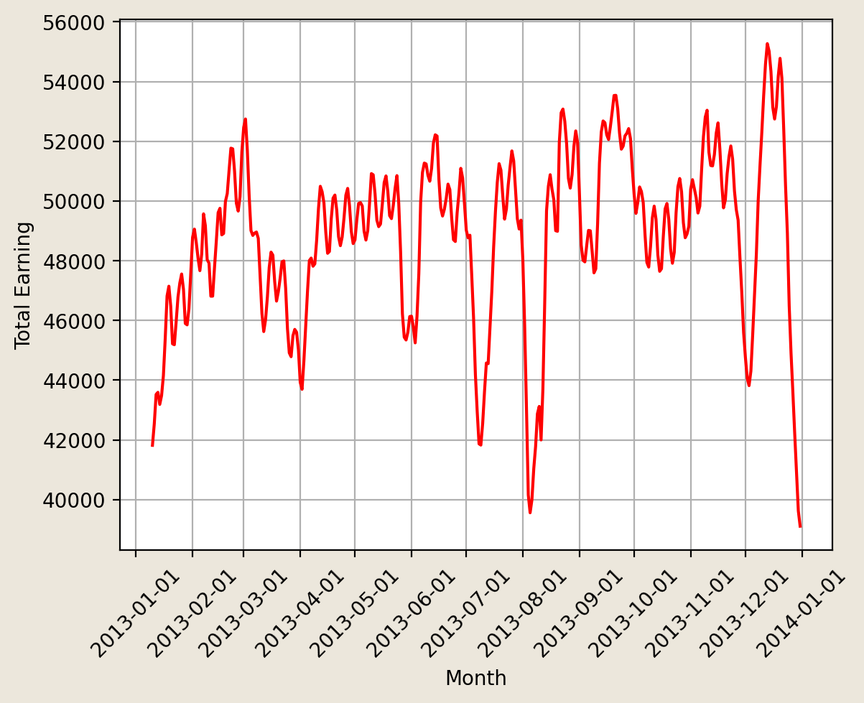
Number
Of
Rides
Total
Earnings
Per
Day
Graph
Comparison
Notes:
And this time, I compared the total daily revenue, and the graph looks similar to the number of trips this time.

Slide 26
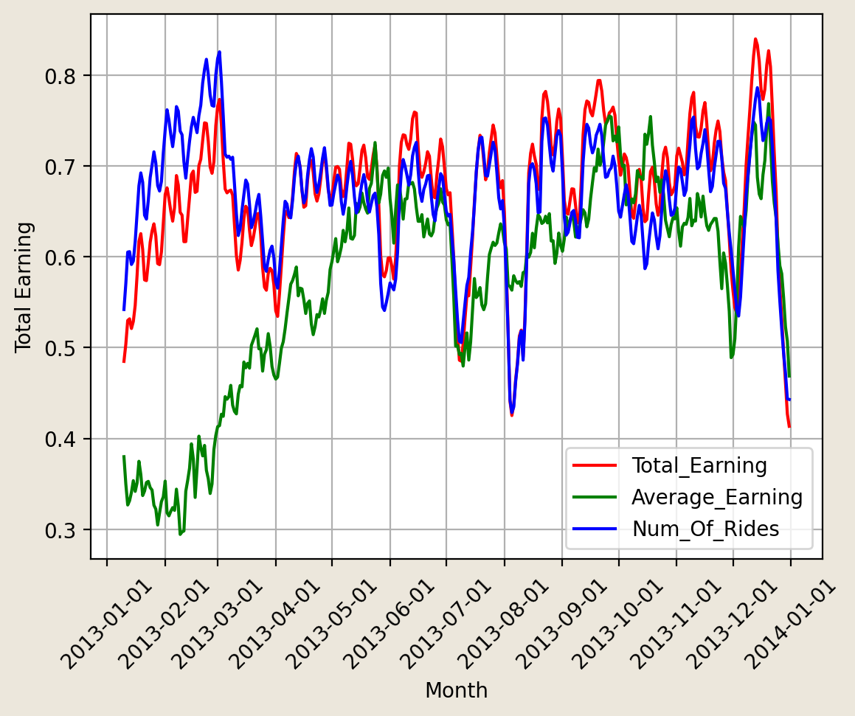
Total
Earnings
Per
Day
Graph
Comparison
Notes:
So, comparing the three graphs, it's clear that the total revenue and the number of rides have similar-looking graphs.

Slide 27
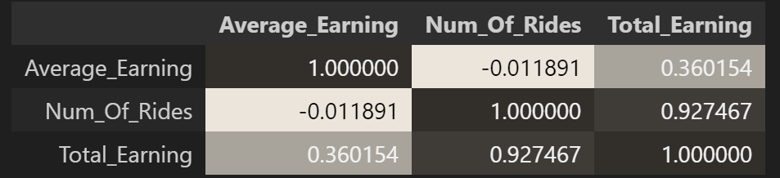
Correlation Chart
Notes:
To make a more definitive comparison, I created a correlation chart, and it clearly showed a strong correlation between total revenue and the number of trips. I could also see that there is some association between total revenue and average revenue per trip.

Slide 28

Conclusion
Next
Steps
Notes:
Analyzing this data, we found that even in 2013, people preferred card payments over cash, taxis usually traveled within about 2 miles, traffic decreased around 5 a.m., revenue was generally lower on weekends, and the number of trips had a stronger impact on total revenue than the average fare per trip.

Slide 29


Conclusion
Next
Steps
Notes:
What I want to explore further from here is, of course, to figure out how to use gmaps again and understand more data with gmap. Also, I want to get the latest data and see if anything has changed, especially the card-to-cash ratio. And I also want to see what changes there were in the data when the coronavirus was spreading.

Slide 30
Questions?
Notes:
Any questions?

